Slide 1
EMPLOYEE MANAGEMENT PROJECT IN SPRING BOOT with Hibernate and ANGULAR
S.RAGHURAMAN
2021-6312
EBEON1121459313

Slide 2
Introduction
An employee management system is a software, that helps your employees to give their best efforts every day to achieve the goals of your organization.
Employee Management System can handle the details about multiple employees.
It is an automated version of manual Employee Management System. It guides and manages employees efforts in the right direction.
It also securely stores and manages personal and other work-related details for your employees.

Slide 3
Technologies :
Spring Boot 2.2.6+
Spring Boot Framework 5.1.4
Maven 3,2+
Technologies Used
Nodejs
Java 8
Spring Data JPA(Hibernate)
Angularjs

Slide 4
Tools and Platform
Here we have used Spring Tool Suite to create a spring boot project which contains Controller, Repository, Entity, Service.
And we used visual studio code to design a frontend part with angular which includes nodejs, components, services, typescript.
For saving the data we have used MySQL Database.

Slide 5
Project Requirements
Create a web application for Employee Management System,
User should be able to :
Get all employee details
Add new employee
Update employee details
Delete an employee
And also includes the following pages:
About us
Contact us
Achievements

Slide 6
APPLICATION ARCHITECTURE
Front-End
Angular
Nodejs
typescript
Back-End
MySQL
DataBase
Employee Controller
Employee Service
Employee Repository

Slide 7
Crud Operation:
Update Module:
It enables admin to add and edit employee records.
01
Delete Module:
This module is created to delete any employee details.
02
Fetch module:
It enables to search employee records easily using employee id.
03
Add Modules:
It enables admin to add employee records.
04

Slide 8
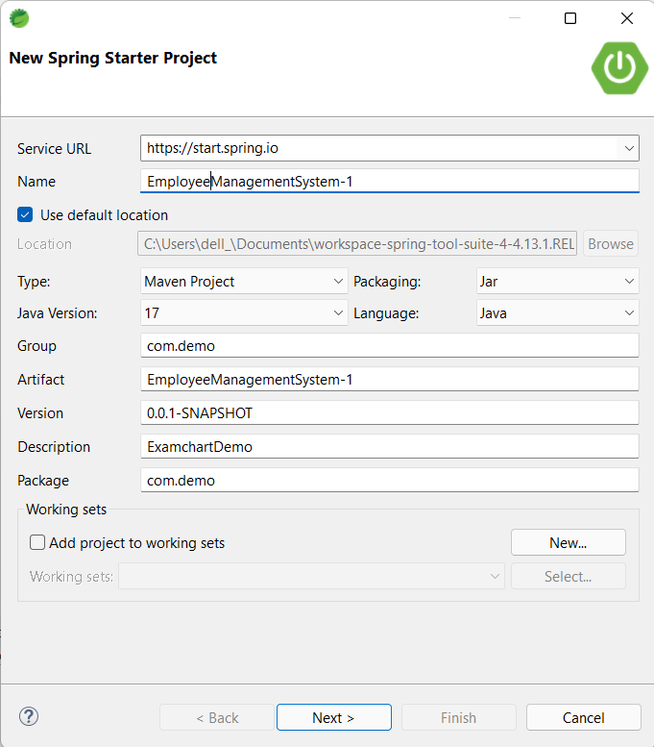
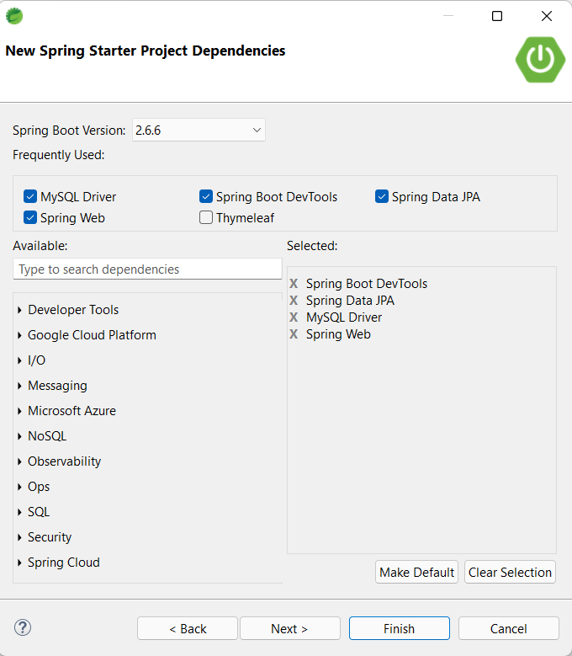
Create Spring Boot Project

Slide 9
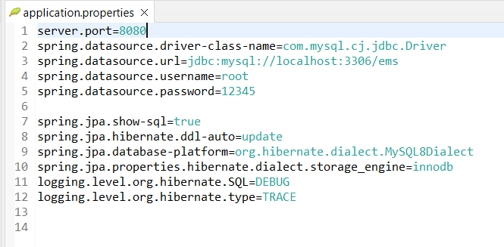
Application Properties

Slide 10
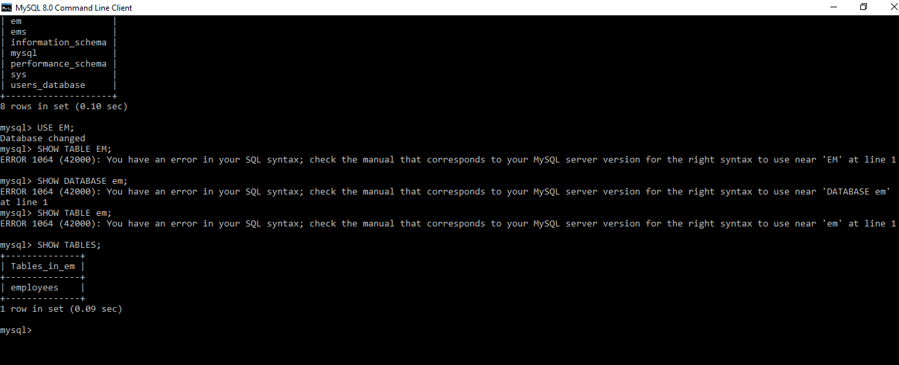
Database Structure

Slide 11
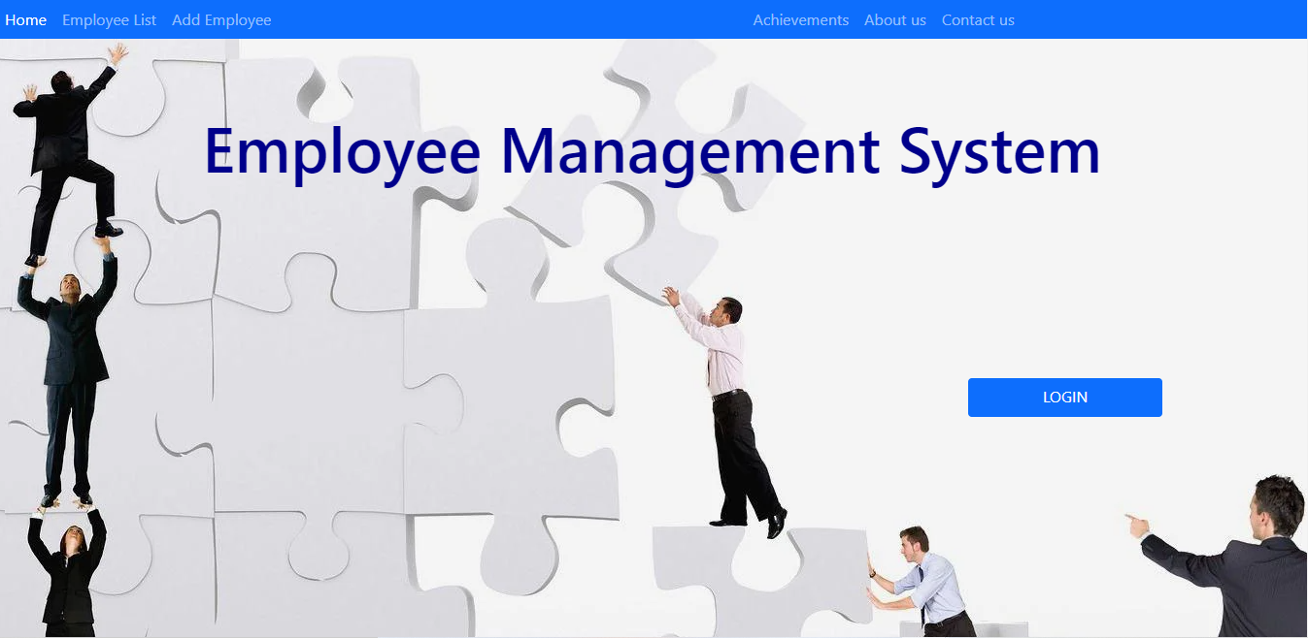
Home Page

Slide 12
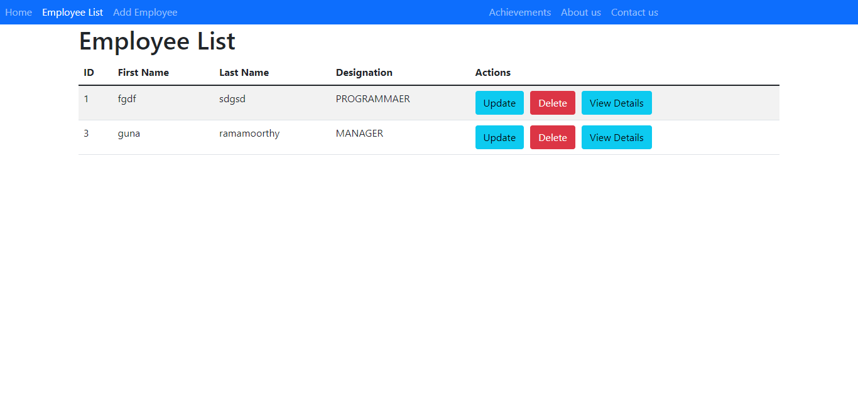
EMPLOYEE LIST

Slide 13
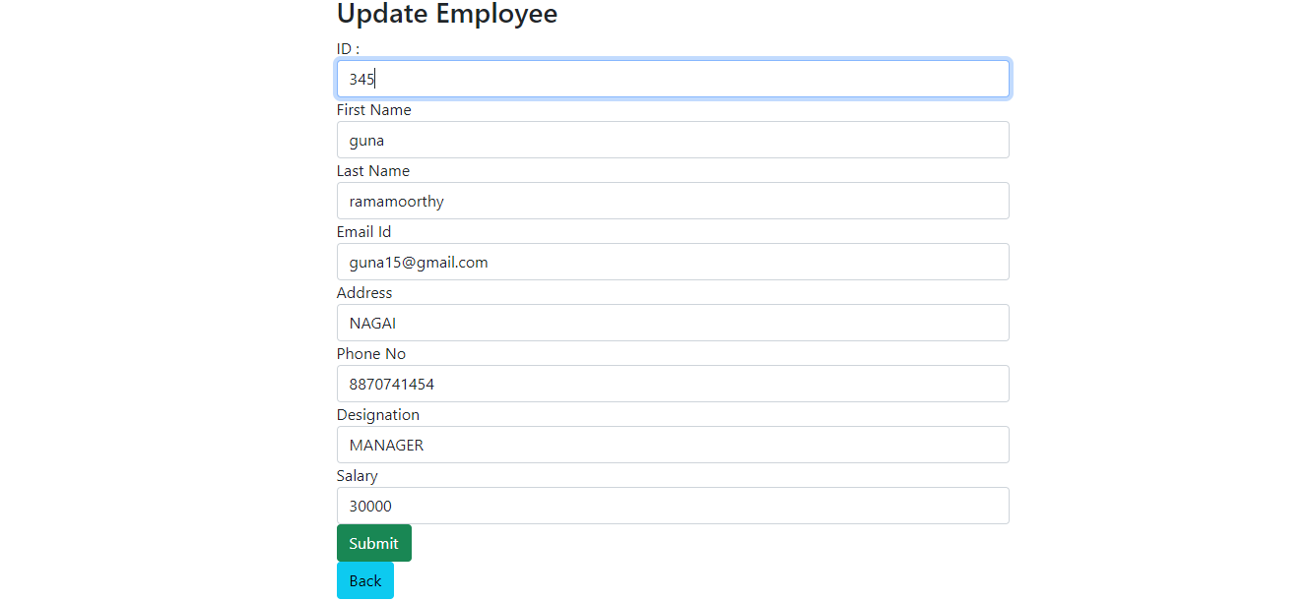
UPDATE EMPLOYEE

Slide 14
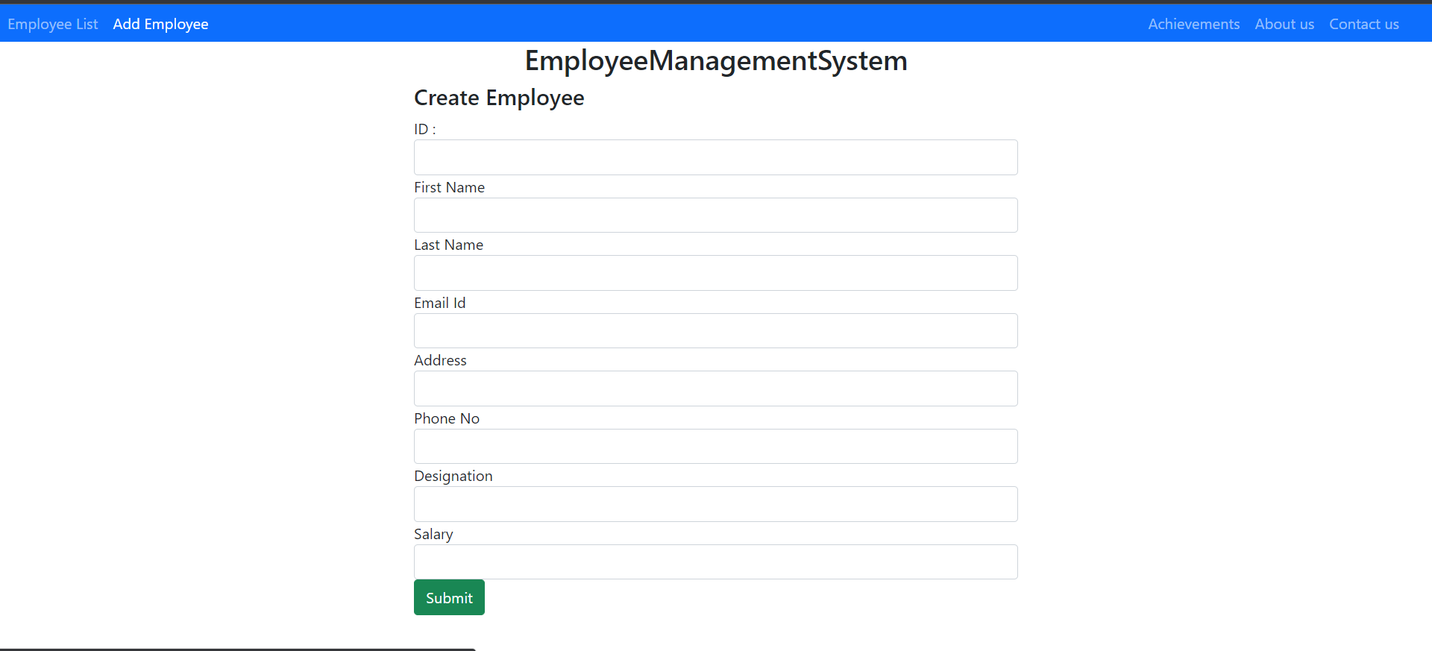
ADD EMPLOYEE

Slide 15
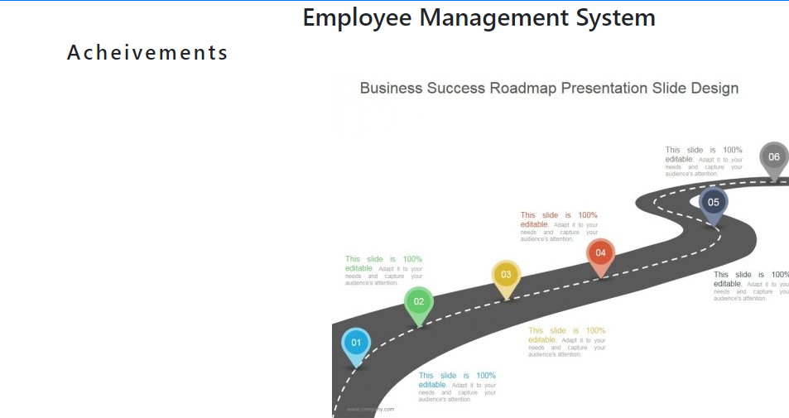
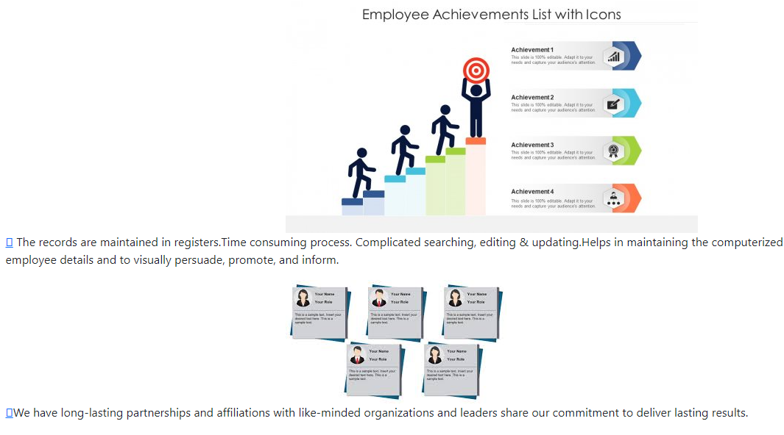
ACHIEVEMENT

Slide 16
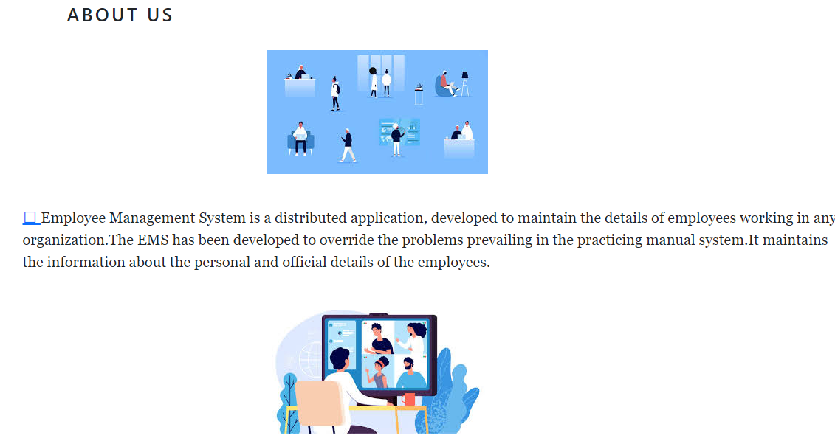
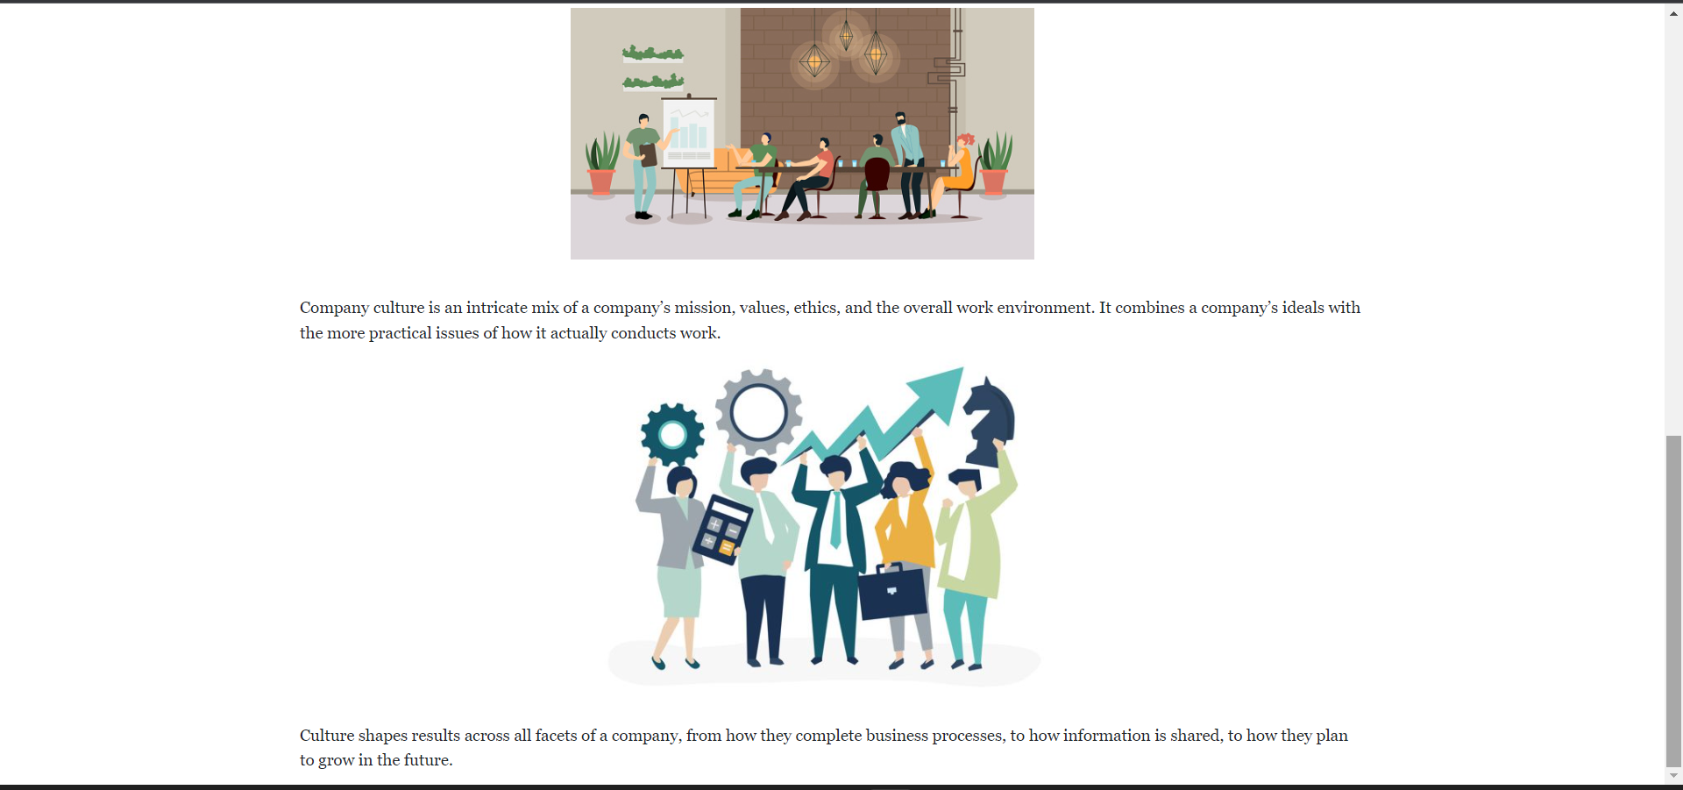
ABOUT US

Slide 17
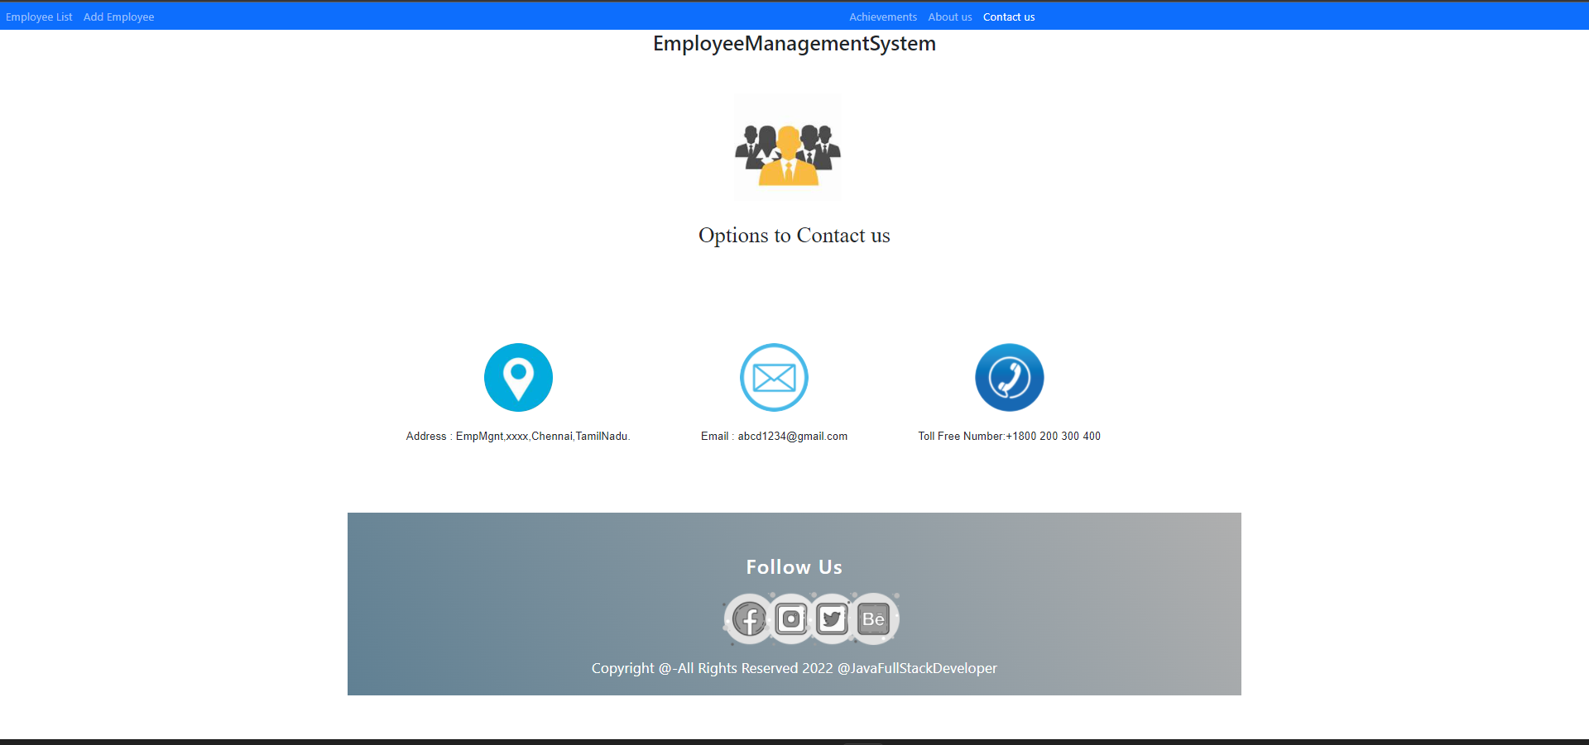
CONTACT US

Slide 18
FEATURES
Implement DELETE Employee Feature
Implement Edit Employee Feature
Implement ADD Employee Feature
IMPLEMENT LIST EMPLOYEE FEATURE

Slide 19
Advantage & Future Scope
Any company will use this framework
User support & Reusable
Repair development deployment
Time Saving
Highly Interactive & Instance Response

Slide 20
Thank you

